Slide 1

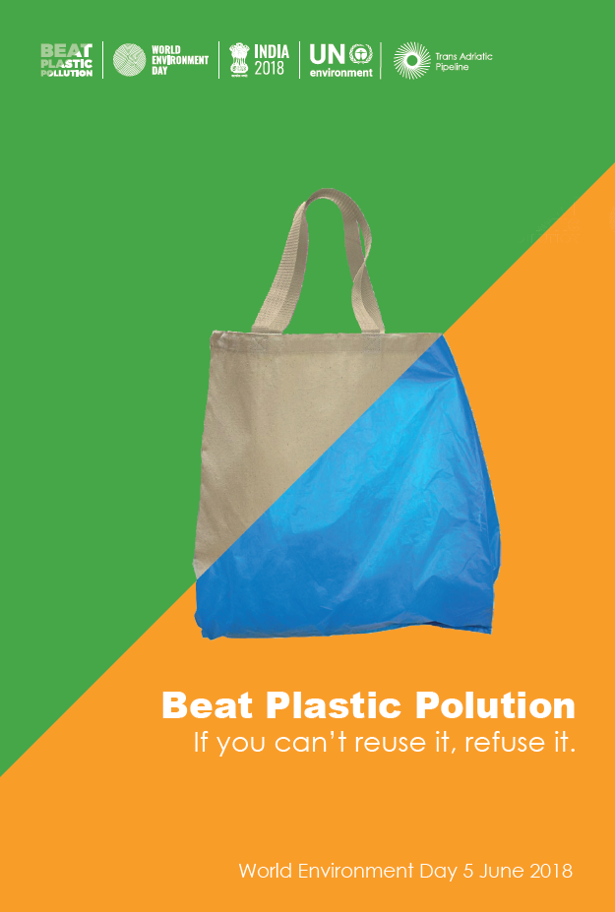



Slide 2

Micha Bräuer
Dipl.-Wirtsch.-Ing.
Adult Educator
Member of swiss environmental protection organisations
European Parliament
  http://braeuer.ch/download/inter_en.pdf
http://braeuer.ch/download/plastic.pptx
*1967 in Germany, since 2001 in Switzerland

Slide 3

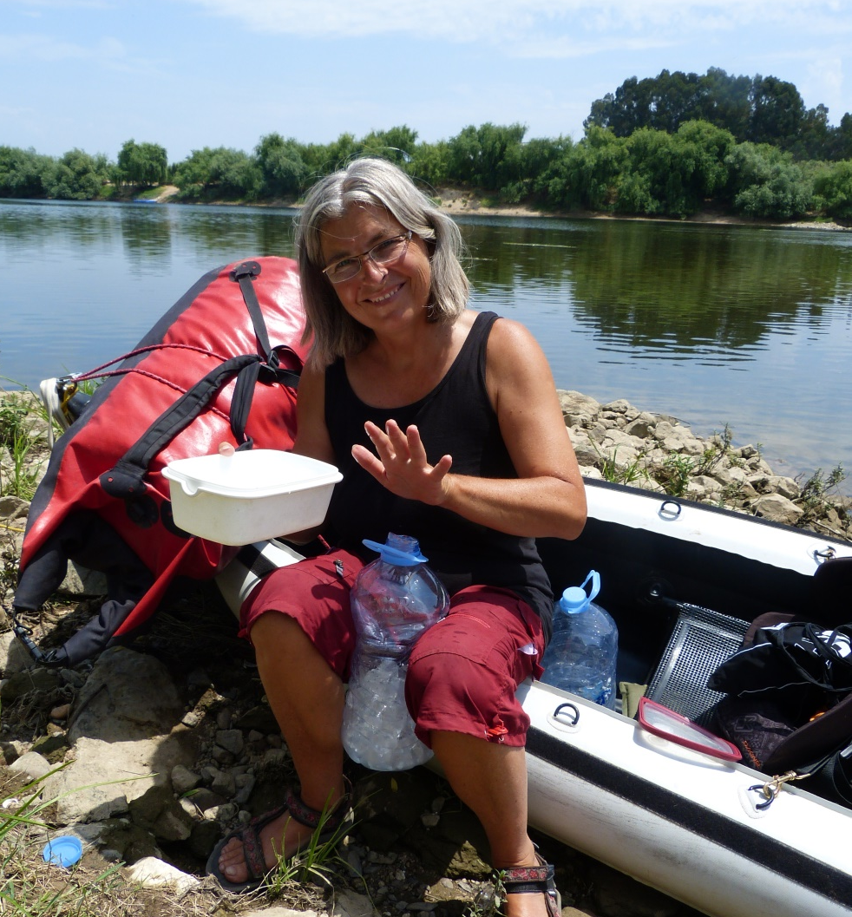
Ursi and Wendelin

Slide 4
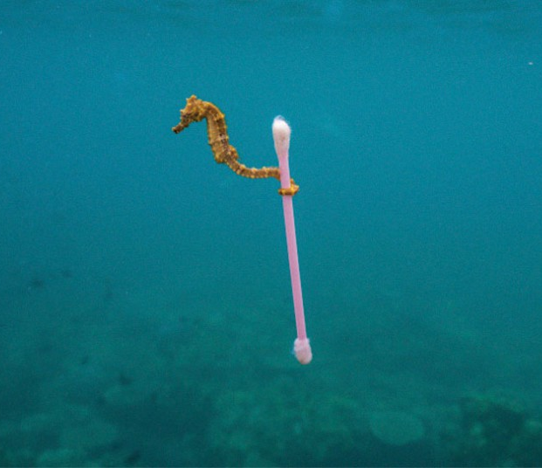
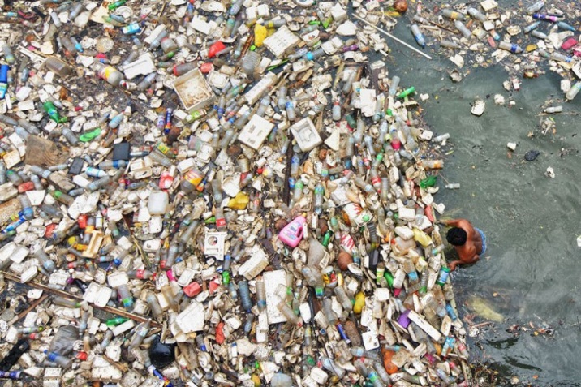
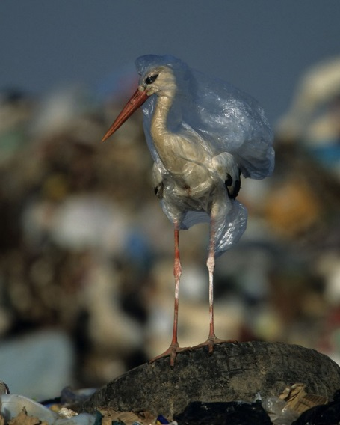
World Environmental Day - Tue 05/06/2018
#BeatPlasticPollution

Slide 5
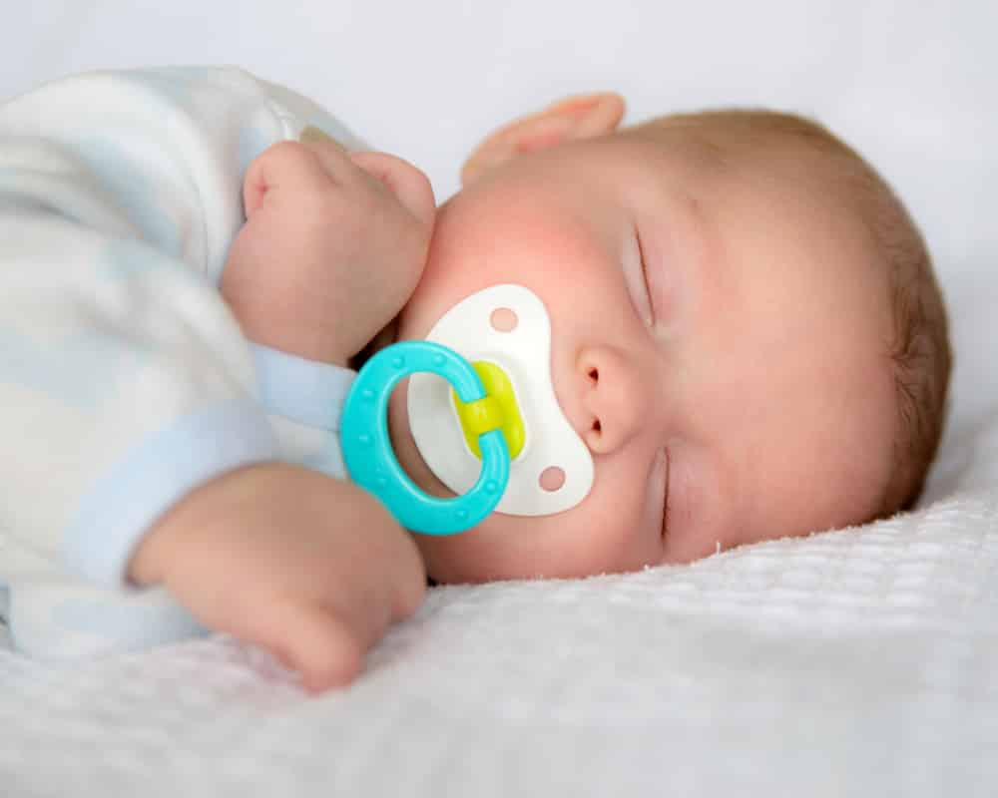
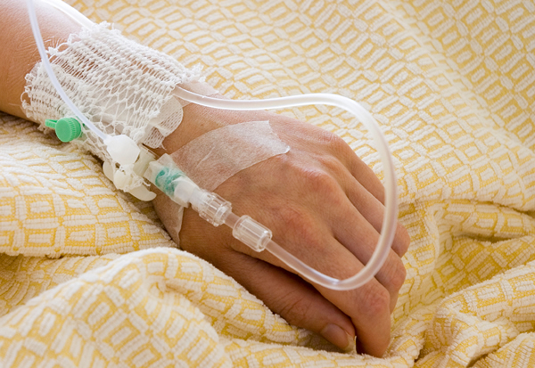
From the Beginning to the End

Slide 6


Content

Slide 7
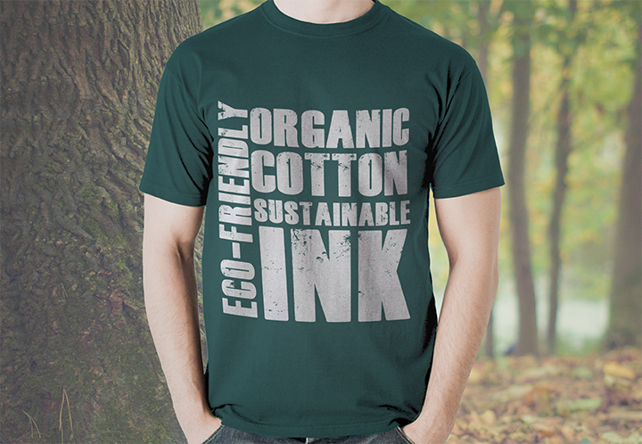
Refuse it
China refuses foreign plastic
Alternatives available

Slide 8
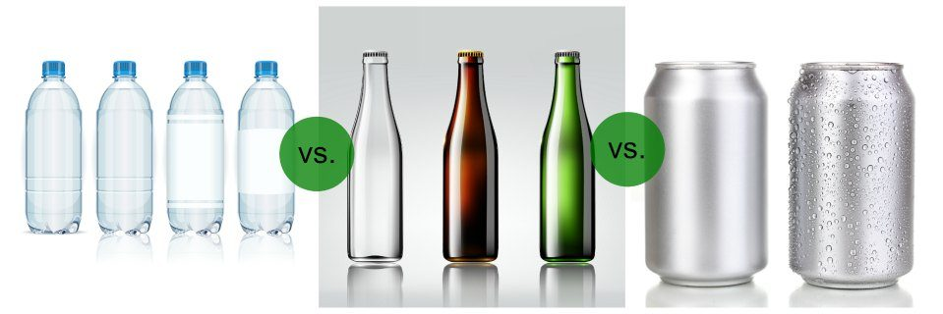
Which is Greener for Packaging?
Where milk&honey flows…

Slide 9
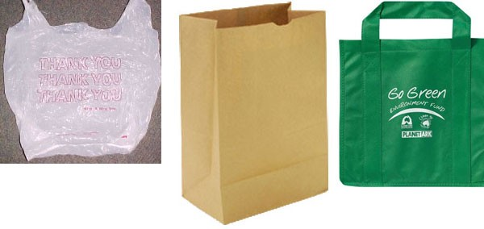
Which is Greener for Carrying?
Raschelsäcke
5rp ➔ 80% reduction
Notes:
Rustle bag

Slide 10
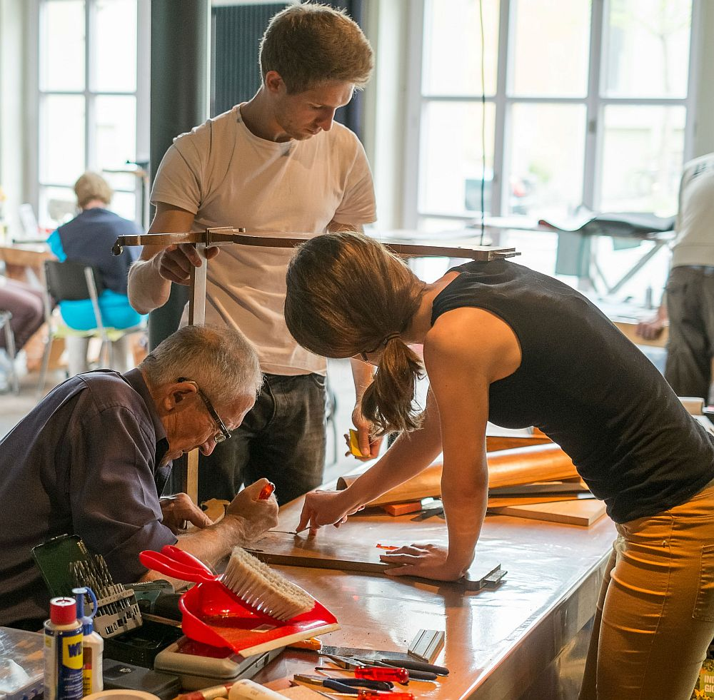
Repair it
Repair Cafes
Next: 09.06.2018
  Zug: Schulhaus Athene
  Luzern: Neubad
https://repair-cafe.ch

Slide 11
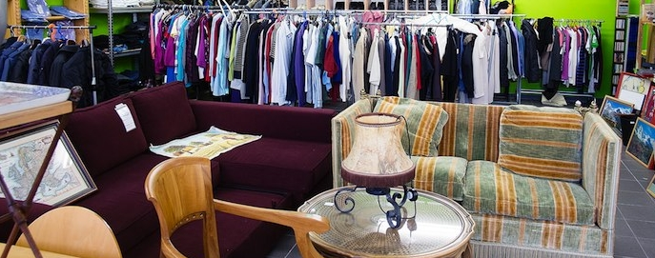
Reuse it
Brockenhäuser
Internet platforms
  Ebay, ricardo
  Tutti, Anibis
  Exsila
Notes:
beekeeper

Slide 12
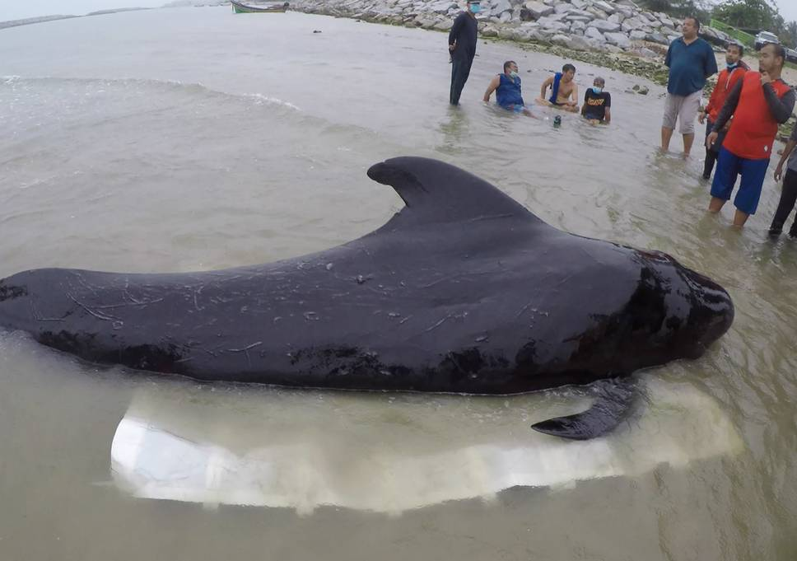
Reduce it
Whale dies from eating more than 80 plastic bags
New EU rules to reduce marine litter

Slide 13
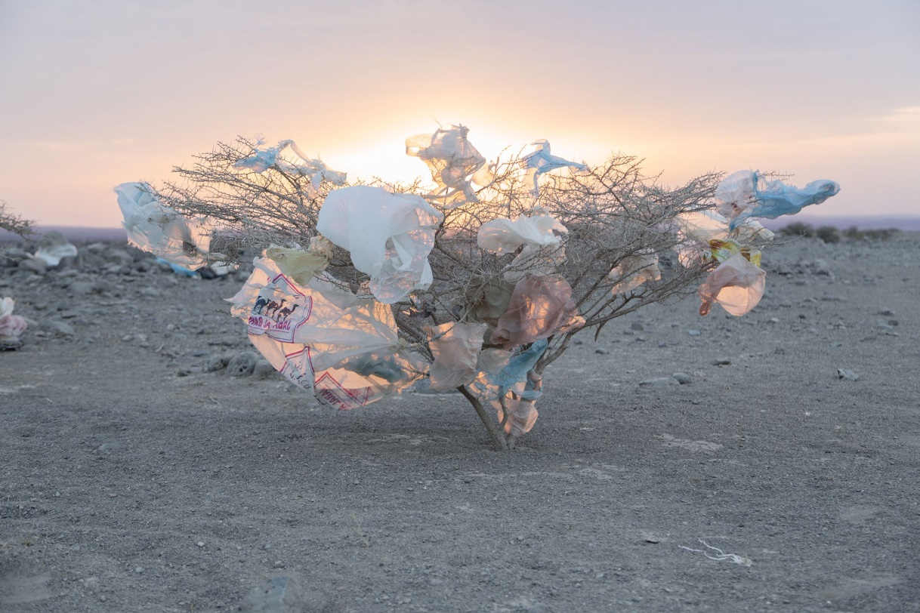
Recycle it
Most important: do not throw non-biological waste into nature
Second most important: separate compost
Recycle!

Slide 14
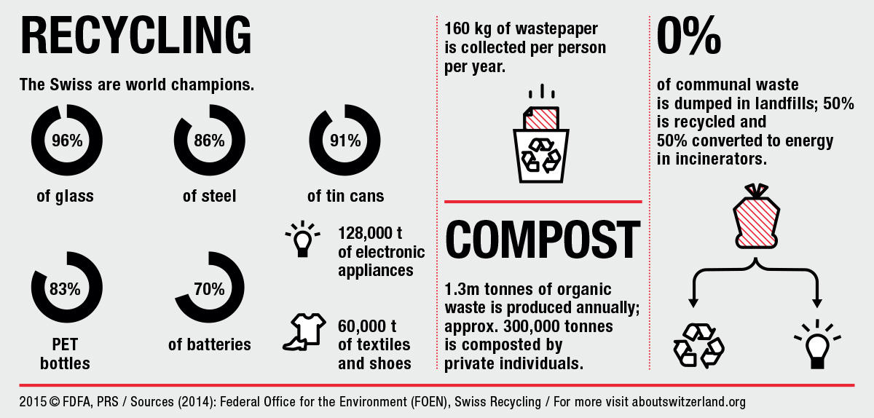
Waste in Switzerland

Slide 15
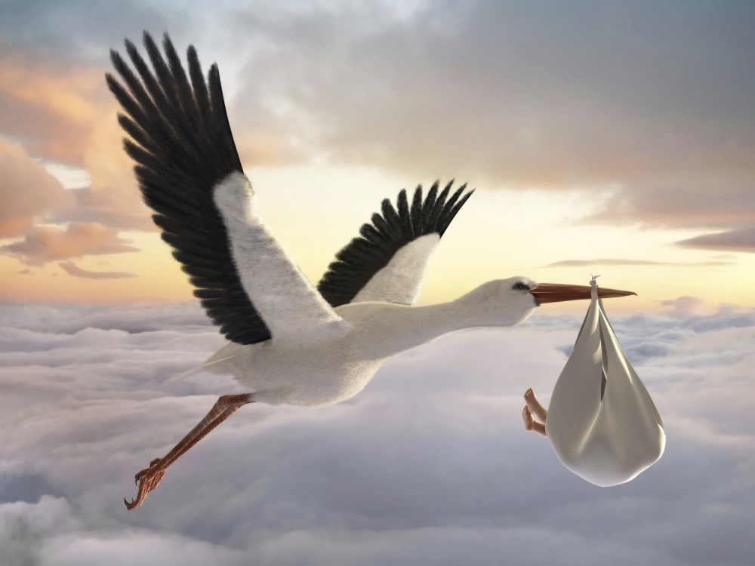
Where do the children come from?

Slide 16
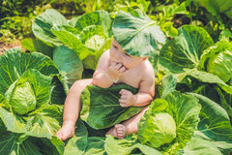
Where do the children come from?
In Switzerland, it differs from canton to canton

Slide 17
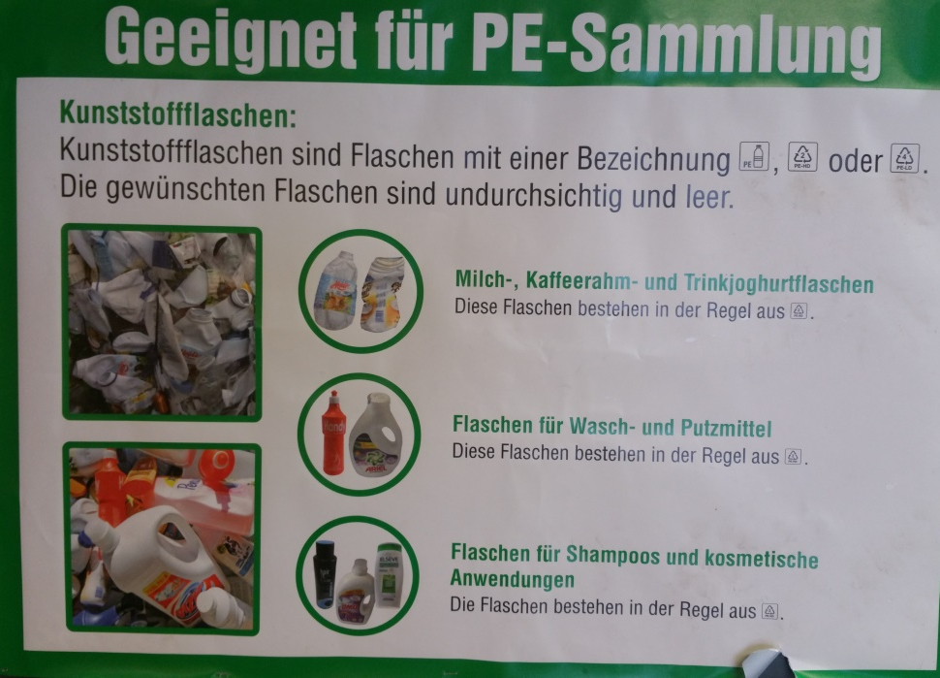
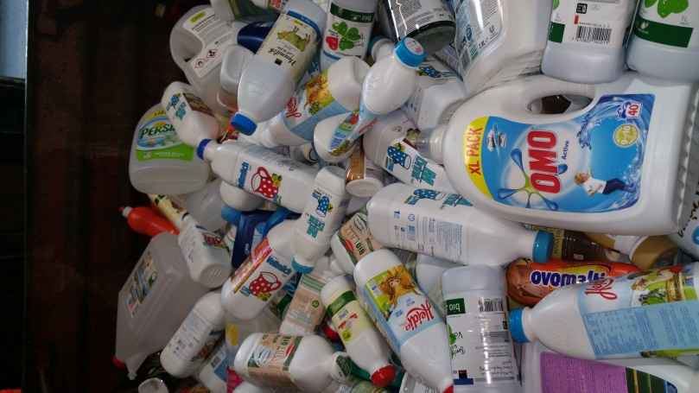
Plastic Recycling
Polyethylene terephthalate: only drink bottles
Polyethylene: only bottles.

Slide 18
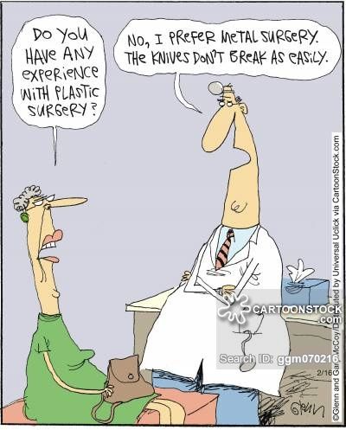
Fun & Facts

Slide 19
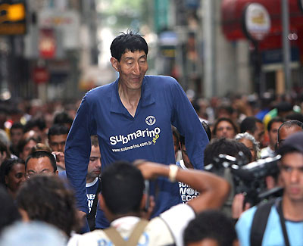
Bao Xishun Saves Dolphins
The world's second tallest man, Bao Xishun, used his long arms reaching 1.06m to remove plastic from the stomachs of 2 dolphins, which ultimately saved their lives after trainers tried numerous other methods.

Slide 20
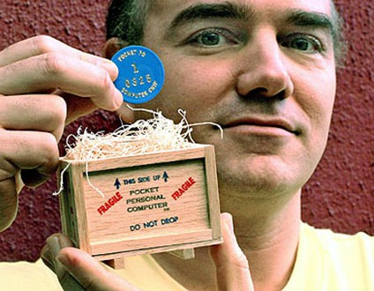
Microsoft sued for illegal use of Pocket PC
Ken Belanger sued Microsoft for illegal use of his "Pocket PC" trademark. Ken's "Pocket PC" was a 1985-made plastic coin with 0 and 1 engraved on the front and back sides.

Slide 21
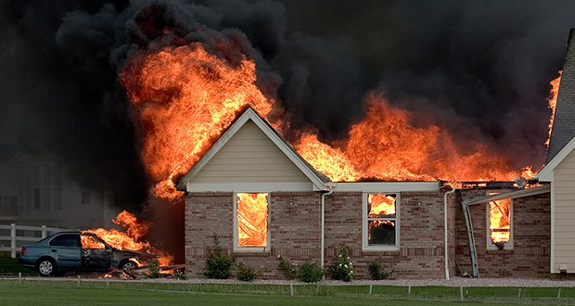
House fires spread 8 times faster
Because of the wide use of plastics and polyurethane foam in modern furnishings, house fires today spread 8 times faster than they did 40 years ago.

Slide 22
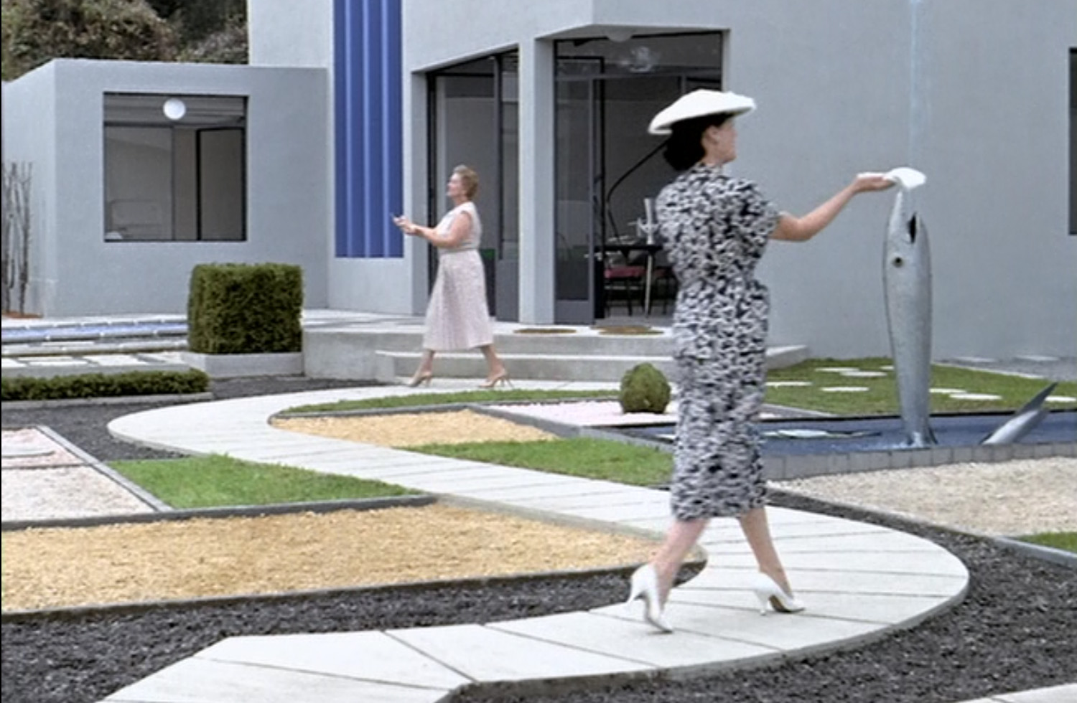
Jacques TATI: Mon oncle, 1958

